Slide 1

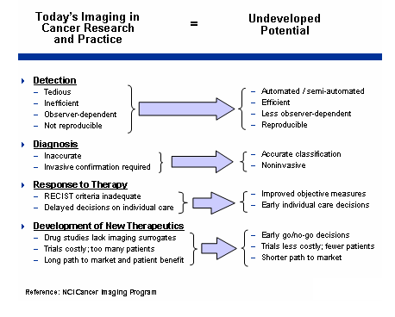
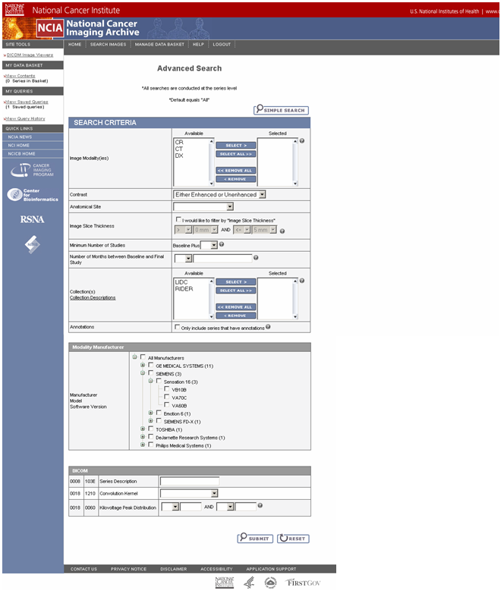

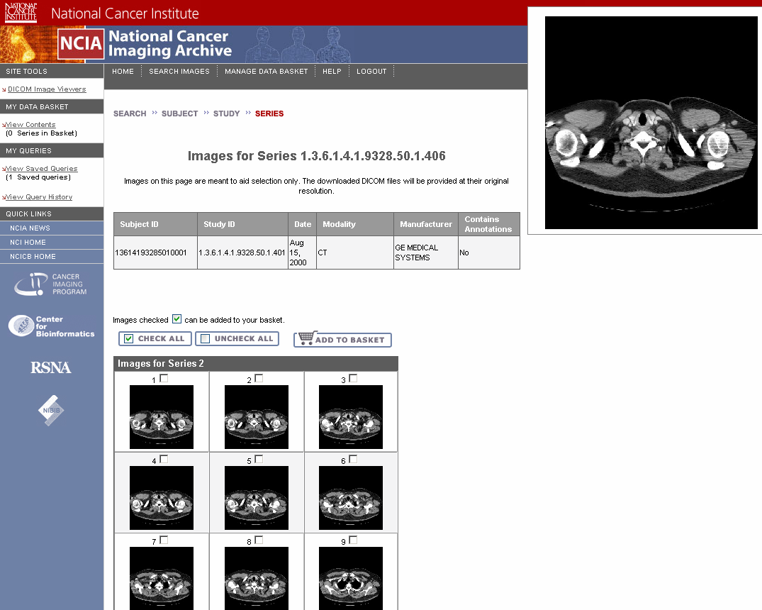
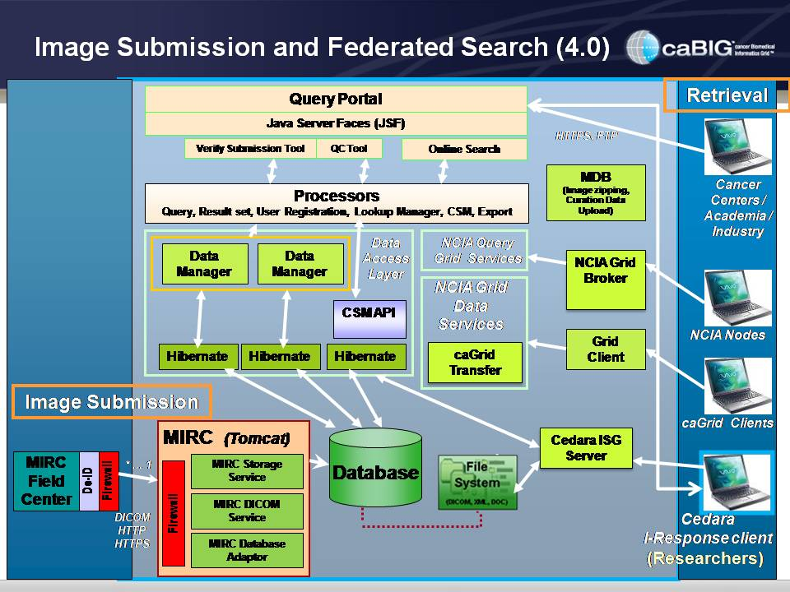
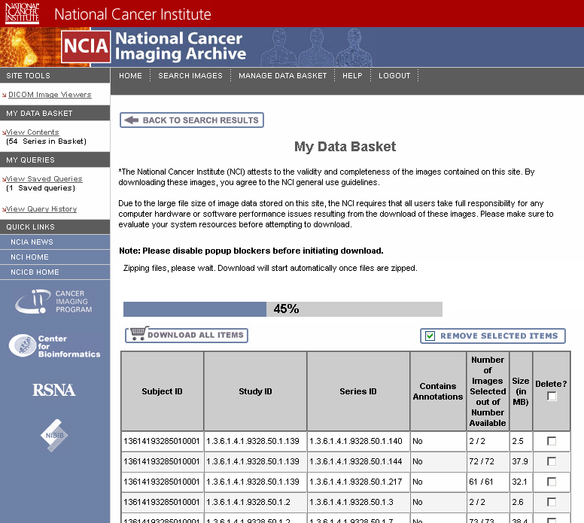
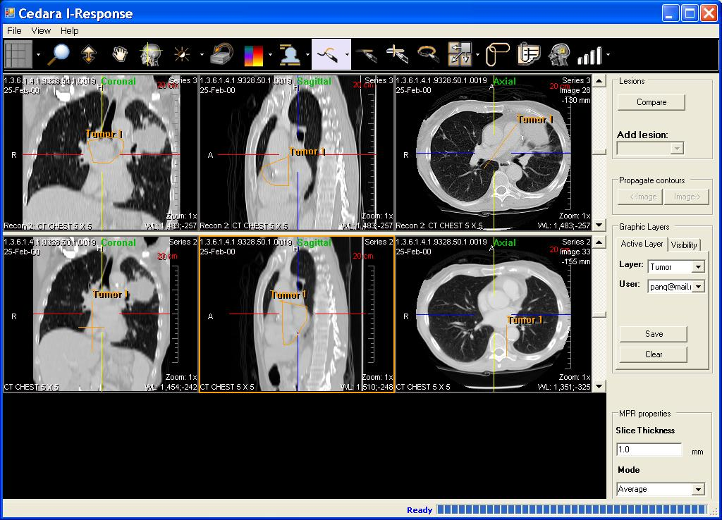
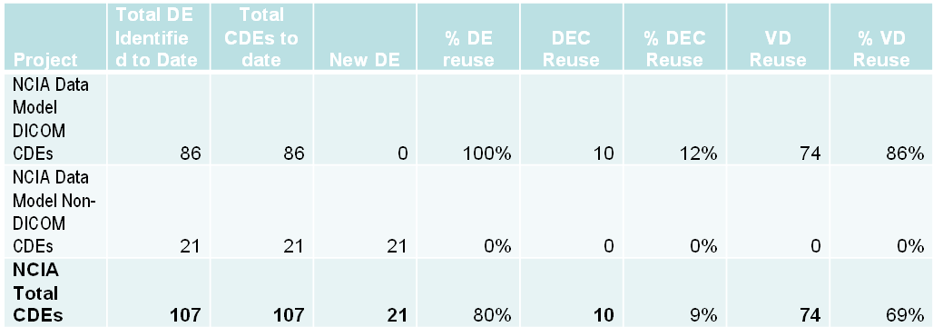
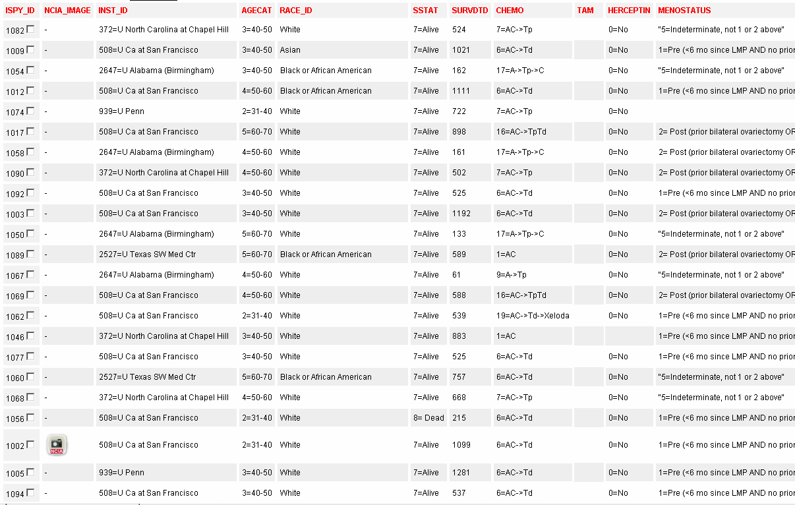
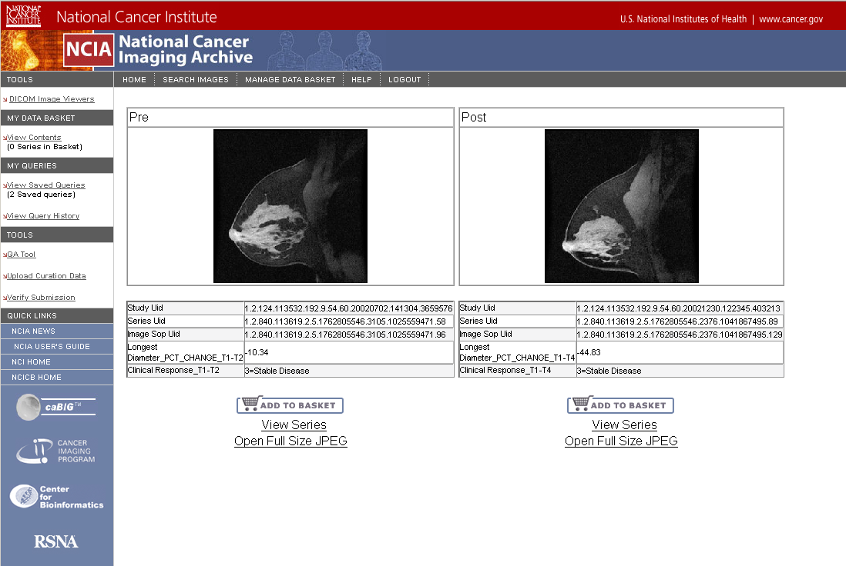
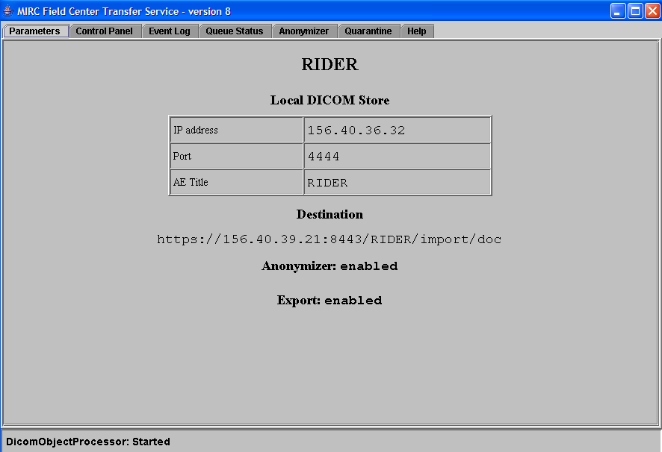
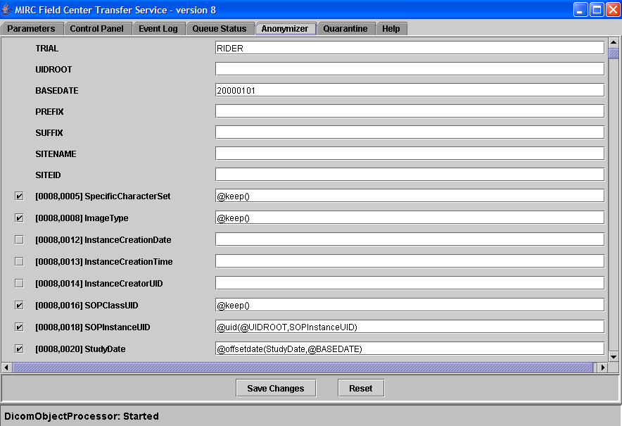
National Cancer Imaging Archive (NCIA):
Leveraging Imaging in Biomarker Discovery and Clinical Research
Sharon Gaheen¹, Jennifer Zeng¹, Eric Kascic¹, Thai Le¹, Qinyan Pan¹, Jim Zhou¹, Yming Hu¹, Ye Wu¹, David Palmer⁷, Larry Holeman⁷, Carl Jaffe³, John Freymann⁸, Laurence Clarke³, John Perry⁶, Eliot Siegel^{4,5,6}, Daniel Sullivan³, Anand Basu², George Komatsoulis², and Ken Buetow²
1. Science Applications International Corporation (SAIC), 2. National Cancer Institute Center for Bioinformatics 3. National Cancer Institute Cancer Imaging Program, 4. University of Maryland Department of Diagnostic
Radiology, 5. VA Maryland Healthcare System, 6. MIRC Committee, Radiological Society of North America, 7. Northern Taiga Ventures Incorporated , 8. SAIC-Frederick, Inc.
SEARCH AND DOWNLOAD FUNCTIONALITY
INTRODUCTION
Image Search
The National Cancer Imaging Archive (NCIA) is a searchable repository of in vivo cancer images. The system provides the cancer research community with public access to de-identified images in DICOM format as well as rich metadata, annotations and markup to be used in the development and validation of analytical software such as computer-aided diagnosis (CAD) tools as well as access to images for interpretation for ongoing studies..
Imaging has become an increasingly important part of cancer and clinical research. There is a greater need for integrative imaging platforms that support the integration of clinical, imaging, genomic and proteomic data. The NCIA is an initiative within the National Cancer Institute to provide a repository and web based application for cancer in vivo images. It provides support for the submission, retrieval, and download of DICOM images with annotations in addition to image markup, storage, and retrieval capabilities.
The system is projected to house millions of in vivo images from clinical trials. Currently, it contains approximately 1.7 million images from five clinical trials along with associated clinical and annotation data.
Access NCIArchive at https://imaging.nci.nih.gov/ncia/ and at https://cabig.nci.nih.gov/tools/NCIA
Users enter criteria to search for images
Search values are determined based on
data parsed from DICOM header during
submission
Criteria available include:
  Modality
  Presence of contrast agent
  Anatomical Site
  Image Slice Thickness
  Minimum Number of Studies for a
  Patient
  Number of Months between Baseline
  and Final Study
  Collection
  Presence of Annotations
  Device manufacturer / model / software
  version
  Series description
  Convolution Kernel
  - Kilovoltage Peak Distribution
Imaging Goals
Advanced Search Page
Cancer Bioinformatics Grid (caBIG)
The overall goal of the effort is to design and develop an in vivo imaging infrastructure that directly aligns with Cancer Bioinformatics Grid (caBIG) principles and the NIH roadmap towards improved patient care and targeted therapies.
NCIA was developed to be compliant with caBIG standards at the “silver” level. NCIA incorporates the caCORE infrastructure and tools (e.g. caCORE SDK, CSM) and has used caCORE SDK to generated caBIG compliant APIs.
Search Results
Results presented hierarchically according
to DICOM model
  Top level results page displays list of
  patients that have images matching
  the search criteria
  After clicking a patient, list of studies
  and series for the patient are displayed
  After clicking a series, JPEG
  thumbnails are displayed for each
  image in the series
Access is restricted by role based
authorization
  Some collections or sites are public,
  others are restricted to a small set of
  users
When viewing results, users can add
patients, series, or images to their data
basket for download
ARCHITECTURE
Search Results – Images for Series
Download Images and Annotation Files
After adding images to their data basket,
users can download them
Files in data basket are added to a zip file
Data sets larger than 3 GB are placed on
an FTP site for download
Smaller data sets are downloaded via
HTTPS
NCIA Architecture
NCIA Application
- Web based application built using Java
- Provides registration, login, searching, download
and query management functionality
- caGrid enabled to support federated search
- Support for Bulk Data Transport (BDT) with gridFTP
- Integrated with Cedara I-Response Workstation for
image visualization
- Runs on J2EE application server such as JBoss
- Presentation layer built using Java Server Faces
- Data access layer built using caCORE SDK
developed as part of caBIG and Hibernate,
an open source object relational mapping tool
- caCORE generates domain classes based on
Unified Modeling Language (UML) object model
File System
- Stores images and annotation files
- Directory structure based on Study Instance UID
from DICOM header
NCIA MIRC Database Export Module
- Parses 107 fields from DICOM header
- Inserts rows into database according to header fields
MIRC Field Center
- MIRC = Medical Imaging Resource Center from
RSNA (Radiological Society of North America)
- Rich client Java application
- Installed at site submitting images
- Sends DICOM images over HTTPS or DICOM protocol
- Anonymizes private data in DICOM header
- Can also send annotation files
MIRC Server
- Web based Java application
- Receives files from Field Center
- Stores files in file system
- Calls MIRC Database Export Module
Relational Database
- Stores data parsed from DICOM header
- Table structure modeled after DICOM Information
Object specification
- For annotation files, stores relationships to series
- Contains references to image files in file system
- In addition to image header data, stores security
information, stored queries and other data
Data Basket
IMAGE VISUALIZATION
Cedara I-Response Integration
Another series can be selected for comparison
-Cedara ISG server handles server-side rendering of images
-Cedara I-Response loads selected series
-Central reads now supported with recently implemented image markup storage and retrieval mechanism
INTEGRATION
It is possible for other applications to integrate with NCIA and use NCIA as an image repository responsible for hosting any DICOM images relevant to the application. Currently, the I-SPY application
(http://ispy-analysis.nci.nih.gov/ispyportal/) is using NCIA to display MRI images of pre-treatment and post-treatment patients in this study. This link between the applications allows researchers to correlate clinical and molecular data with in vivo image results. NCIA allows the user to view the full size image, download the original DICOM images and also view all images related to this patient.
NCIA Object Model Common Data Element (CDE) reuse
IMAGE SUBMISSION FUNCTIONALITY
Image Submission
Clinical Report from I-SPY
- Leverages MIRC software from RSNA
Configure anonymization of DICOM header
at submitting site
Securely transmit image over HTTPS to
MIRC server
Image quality is checked by curator prior to
making image visible
MRI Images Displayed in NCIA
FUTURE PLANS
The development of NCIA and submission of images to its archive is an ongoing effort. Future enhancements will include caCORE CSM 3.2 integration, Query NCIA Archive across GRID, standardize database on MySQL platform, migration to the eXtensible Imaging Platform (XIP) architecture, as well as improvements to the NCIA WEB User interface to improve and expand search capabilities.
Acknowledgements for Research Support
Transmission Parameters
Anonymization Configuration
This effort was supported by funds from National Cancer Institute, the National Cancer Institute Center for Bioinformatics, and the Cancer Imaging Program.

